Slide 1
Agenda Item 3:
Strategic Planning Process

Slide 2
Grounding – Our Purpose
Supporting projects that help implement the Oregon Conservation Strategy and creates new opportunities for wildlife-associated conservation, education and recreation.
A public-private partnership that supports projects to implement the Oregon Conservation Strategy and connect people with the outdoors.
Empowers implementation of the Oregon Conservation Strategy and connects people with outdoor opportunities.
The committee advise ODFW and the Fish and Wildlife Commission regarding use of the Fund

Slide 3
OCRF Strategic Plan
The strategic plan is a tool to help define OCRF’s direction for the next two biennia (July 2023 – June 2027)
Vision and Mission
Actions to Achieve the Goals
Priority Areas
Goals
Values

Slide 4
What to Expect – The Process!
Facilitated discussions
Stakeholder Input*
Draft Plan
Final Plan
August – Grounding, Planning Process, Hopes/Expectations, Stakeholder Outreach Options, Strengths/Weaknesses
September - Finish SWOT/PEST, Review/Validate OCRF Vision/Mission/Values
October - Discuss Themes from the Outreach & impact on OCRF Priorities, OCRF’s Role vs. others, OCRF Priorities
November - Finalize Priorities, Discuss Goals/Objectives (how will we gauge our success) and Potential Actions
December - Refine and Prioritize Goals and Actions
*Scope to be managed based on timelines

Slide 5
Key Questions to be Answered
What has the OCRF accomplished thus far?
What should be our strategic priorities?
Do we have specific goals related to those priorities?
What actions will we take in the next 4 years?
Are we effective in the communication of our accomplishments?
Does OCRF need effectiveness monitoring and for what purpose?
How do we create an adaptable grant program that can be scaled up or down depending on available funding?
What are our storytelling and communication goals?
Is there a need for continued private fundraising?
What type of fundraising activities should be completed and by whom?
How do we engage with partners who are interested in the OCRF?

Slide 6
Member Input
What are your hopes and/or expectations for the process?
The strategic plan document itself?

Slide 7
Agenda Item 4:
Stakeholder Outreach

Slide 8
Benefits to Consider
Input for the Strategic Plan
Understand the needs and desires of interested parties
Consider differing perspectives
Foster connections and buy-in for your priorities
Post Strategic Plan Finalization
Gartner support achieving your goals
Gather input that will help in completing actions
Ask for assistance (where applicable)

Slide 9
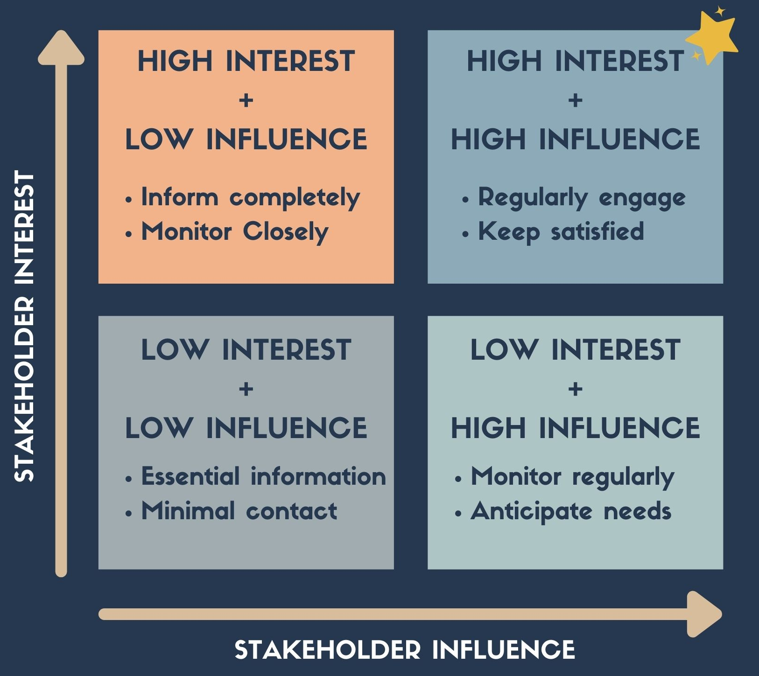
Stakeholder Mapping

Slide 10
Pre-Strategic Plan – Potential Options
Interviews
Surveys

Slide 11
Agenda Item 5:
Building the Foundation

Slide 12
Current State - SWOT/PEST
Today’s Focus
Strengths
Weaknesses

