Slide 1


September 3rd, 2024
1:00pm – 4:00pm
Oregon Conservation and Recreation Fund
Advisory Committee Meeting
Virtual Meeting

Slide 2
Agenda Item 1:
Review and Approve Meeting Minutes
(August 6th, 2024)

Slide 3
Draft Motion Templates re: Minutes
I move to approve the August 6th, 2024 meeting minutes with the continued authority to correct spelling, grammar, and punctuation.
I move to approve the August 6th, 2024 meeting minutes with the addition/correction/ deletion of ____ on page ___, line ____, and continued authority to correct spelling, grammar, and punctuation.

Slide 4
Agenda Item 2:
OCRF Scoring and Reviewer Feedback

Slide 5
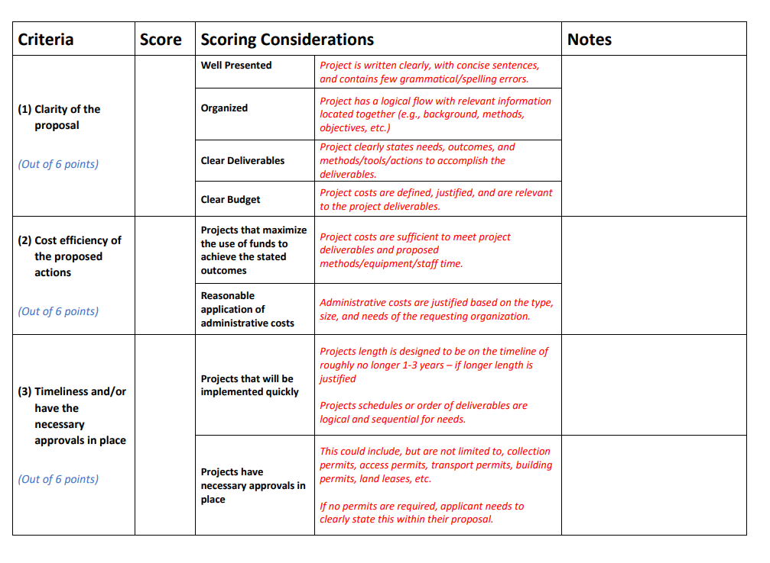
Lessons learned from providing reviewer feedback to applicants from Round 7:
Comments are summarized and provided to applicants (*valuable and appreciated)
Request for more feedback from reviewers, both appreciative and constructive

Slide 6
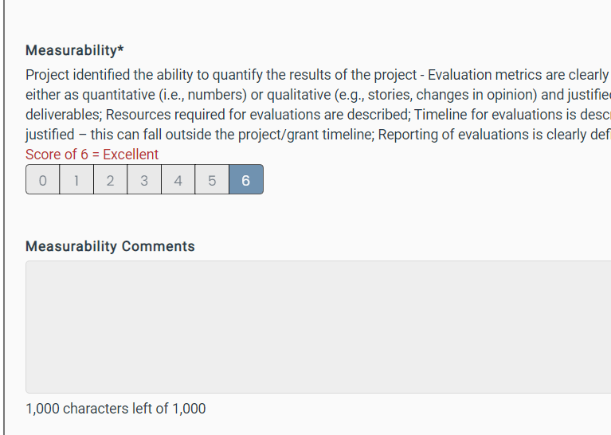
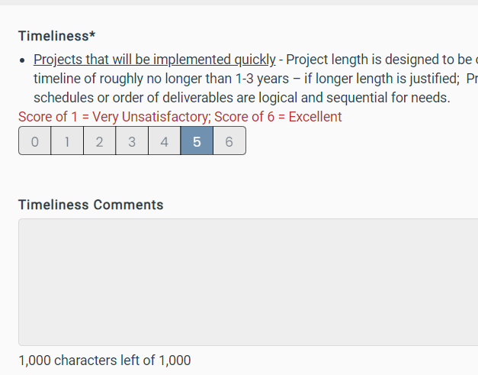

Slide 7
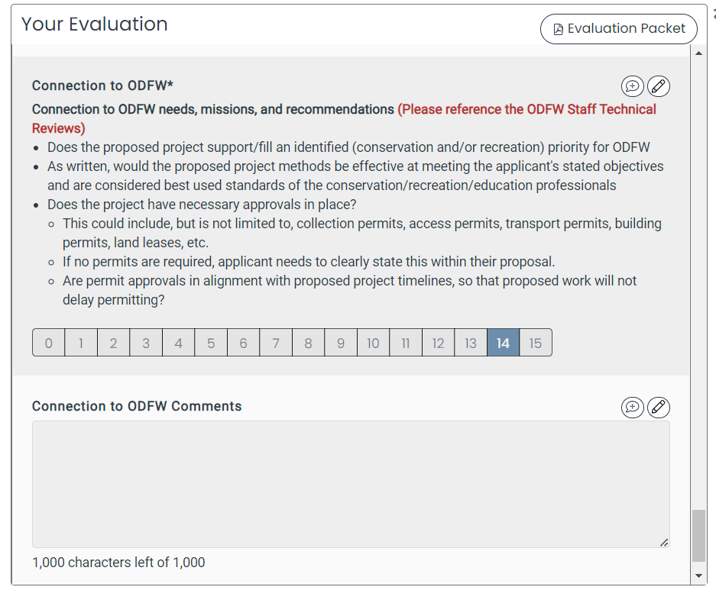
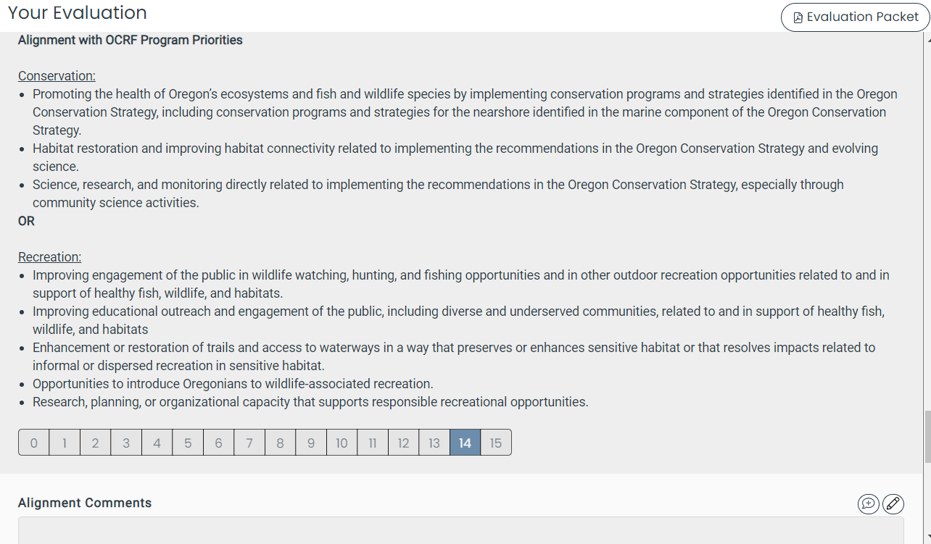
General Alignment Sections – more comments requested

Slide 8
OCRF Fall 2024 RFP Timeline
Request for Proposals (RFP) – Open August 30th, 2024
Official RFP Guidance made public (open for 60 days)
Request for Proposals (RFP) – Close October 29th, 2024
Technical Review Period – Nov 12th to Dec 17th, 2025
OCRF Advisory Committee Review Period – Dec 18th to Jan 15th, 2025
OCRF Advisory Committee Recommendations – Feb 4th, 2025 meeting
ODFW Commission Voting – March 14, 2025
Release of funds following contracting process – May 2025

Slide 9
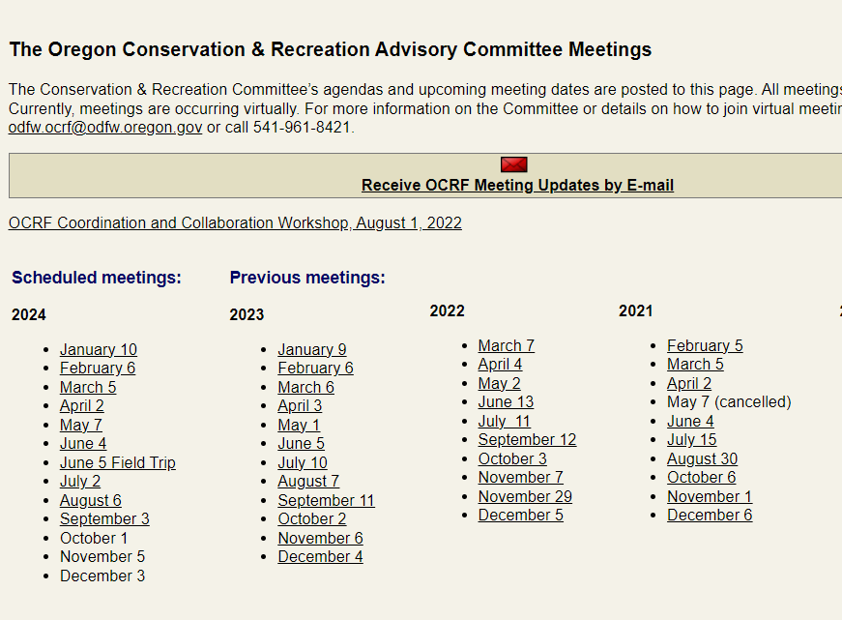

Slide 10
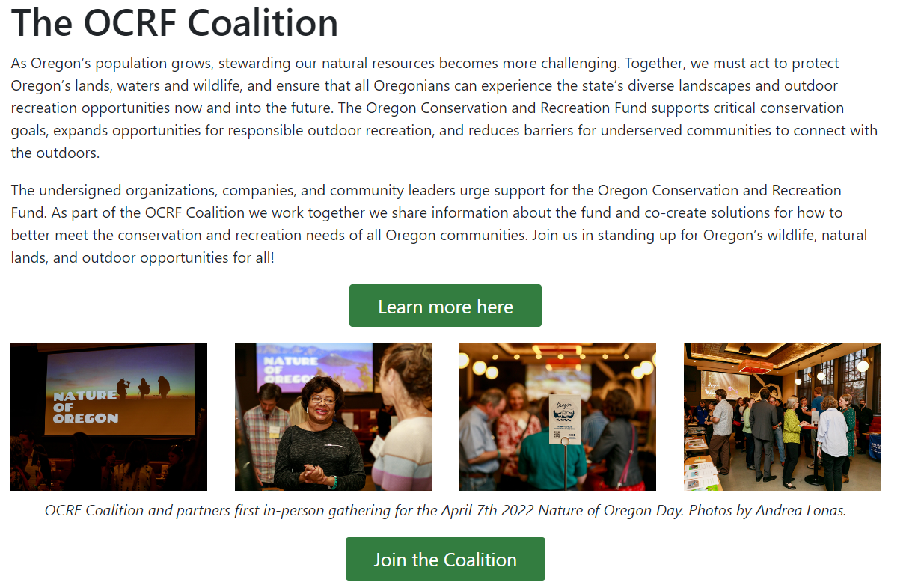
Website Updates
Mobile-friendly
Modern look/feel
More user-friendly
Easier to navigate

Slide 11
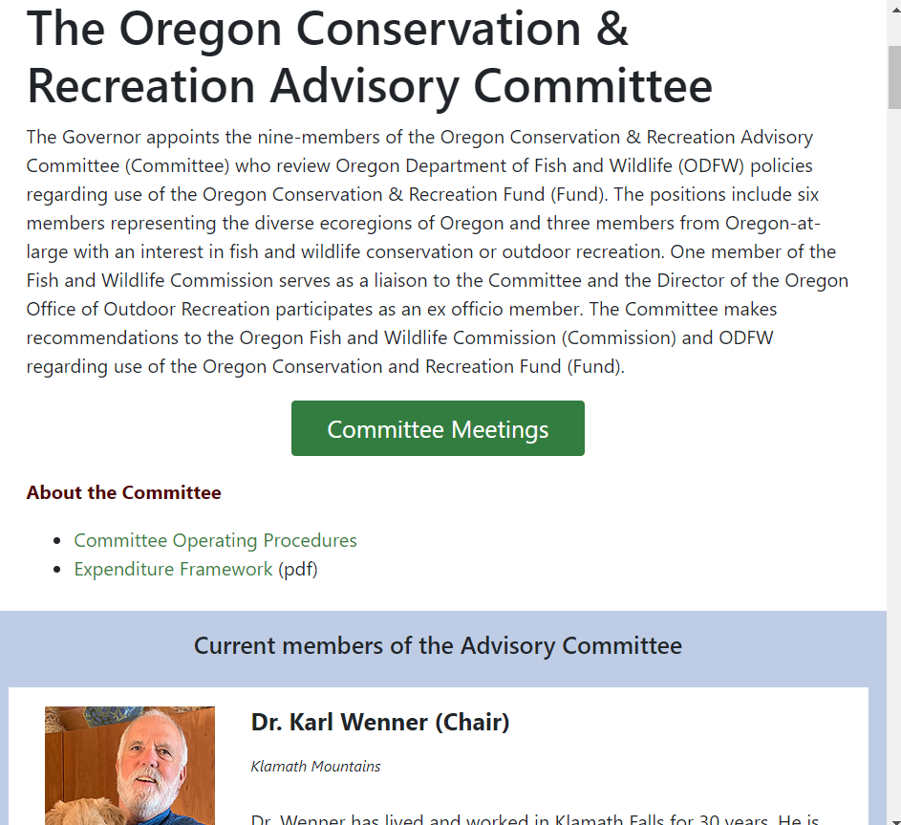
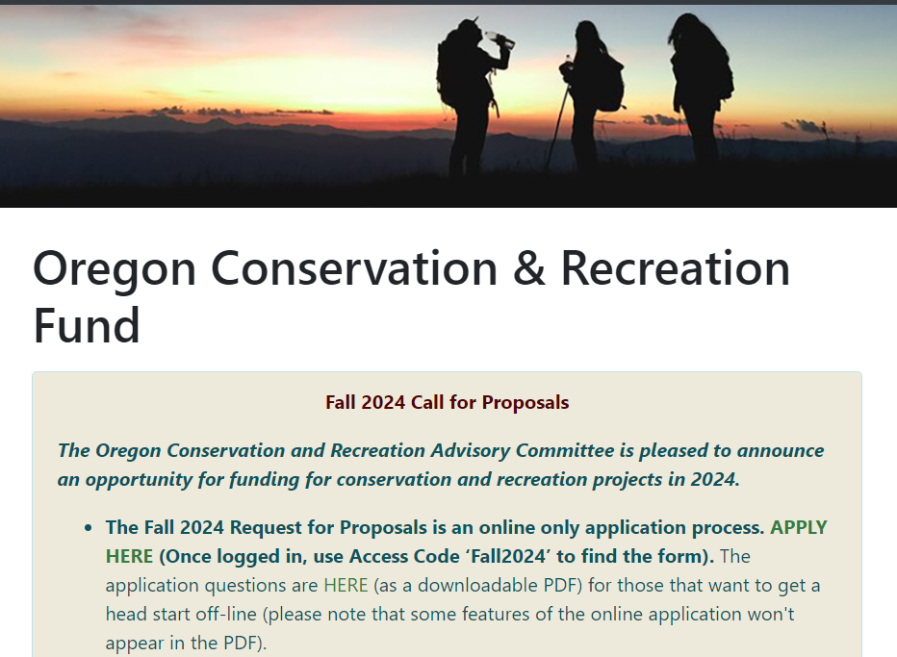

Slide 12
Agenda Item 3 :
Public Comment

Slide 13
Agenda Item 4:
OCRF Project Presentation
Wolverine Tracking Project - Teri Lysak with Cascadia Wild

Slide 14
Agenda Item 5:
Break
(Please be back in 5 min)

Slide 15
Agenda Item 5:
OCRF Communications Strategy Update

Slide 16
OCRF Program Updates
OCRF Communications Strategy
OCRF Communications Strategy
OCRF Chairs, ODFW staff, and OWF developed a Communications Planning - Scope of Work
RFP was released by Oregon Wildlife Foundation (Tim Greseth)
RFP closed on July 24th. 11 proposals received
Review / Selection process almost complete
Notes:
Conducted outreach, and OCRF representation at the Oregon outdoor recreation programs, trail alliances, Diversifying the pool of applicants that apply to OCRF. Hopefully this helps address the

Slide 17
Agenda Item 7:
Meeting Wrap Up and Next Steps

Slide 18
OCRF Budget Update – July ‘24
Base Program: $801,704
Calculated using (21-23 ending fund balance) + (23-25 revenue to date) – (allocated to projects)
Does not include future ELS donations for the remainder of 23-25, or interest that will be deposited in August
Drought Package: $1,607,609
(Remaining funds) – (Current Committed Projects + Personnel costs)
ARPA: $0
All Federal ARPA funds have been committed to projects
Personnel Costs | 80,000
Current Committed Projects | 2,920,034
Other (held by Oregon Wildlife Foundation): Oregon is Alive ~ $30,000

