Slide 1
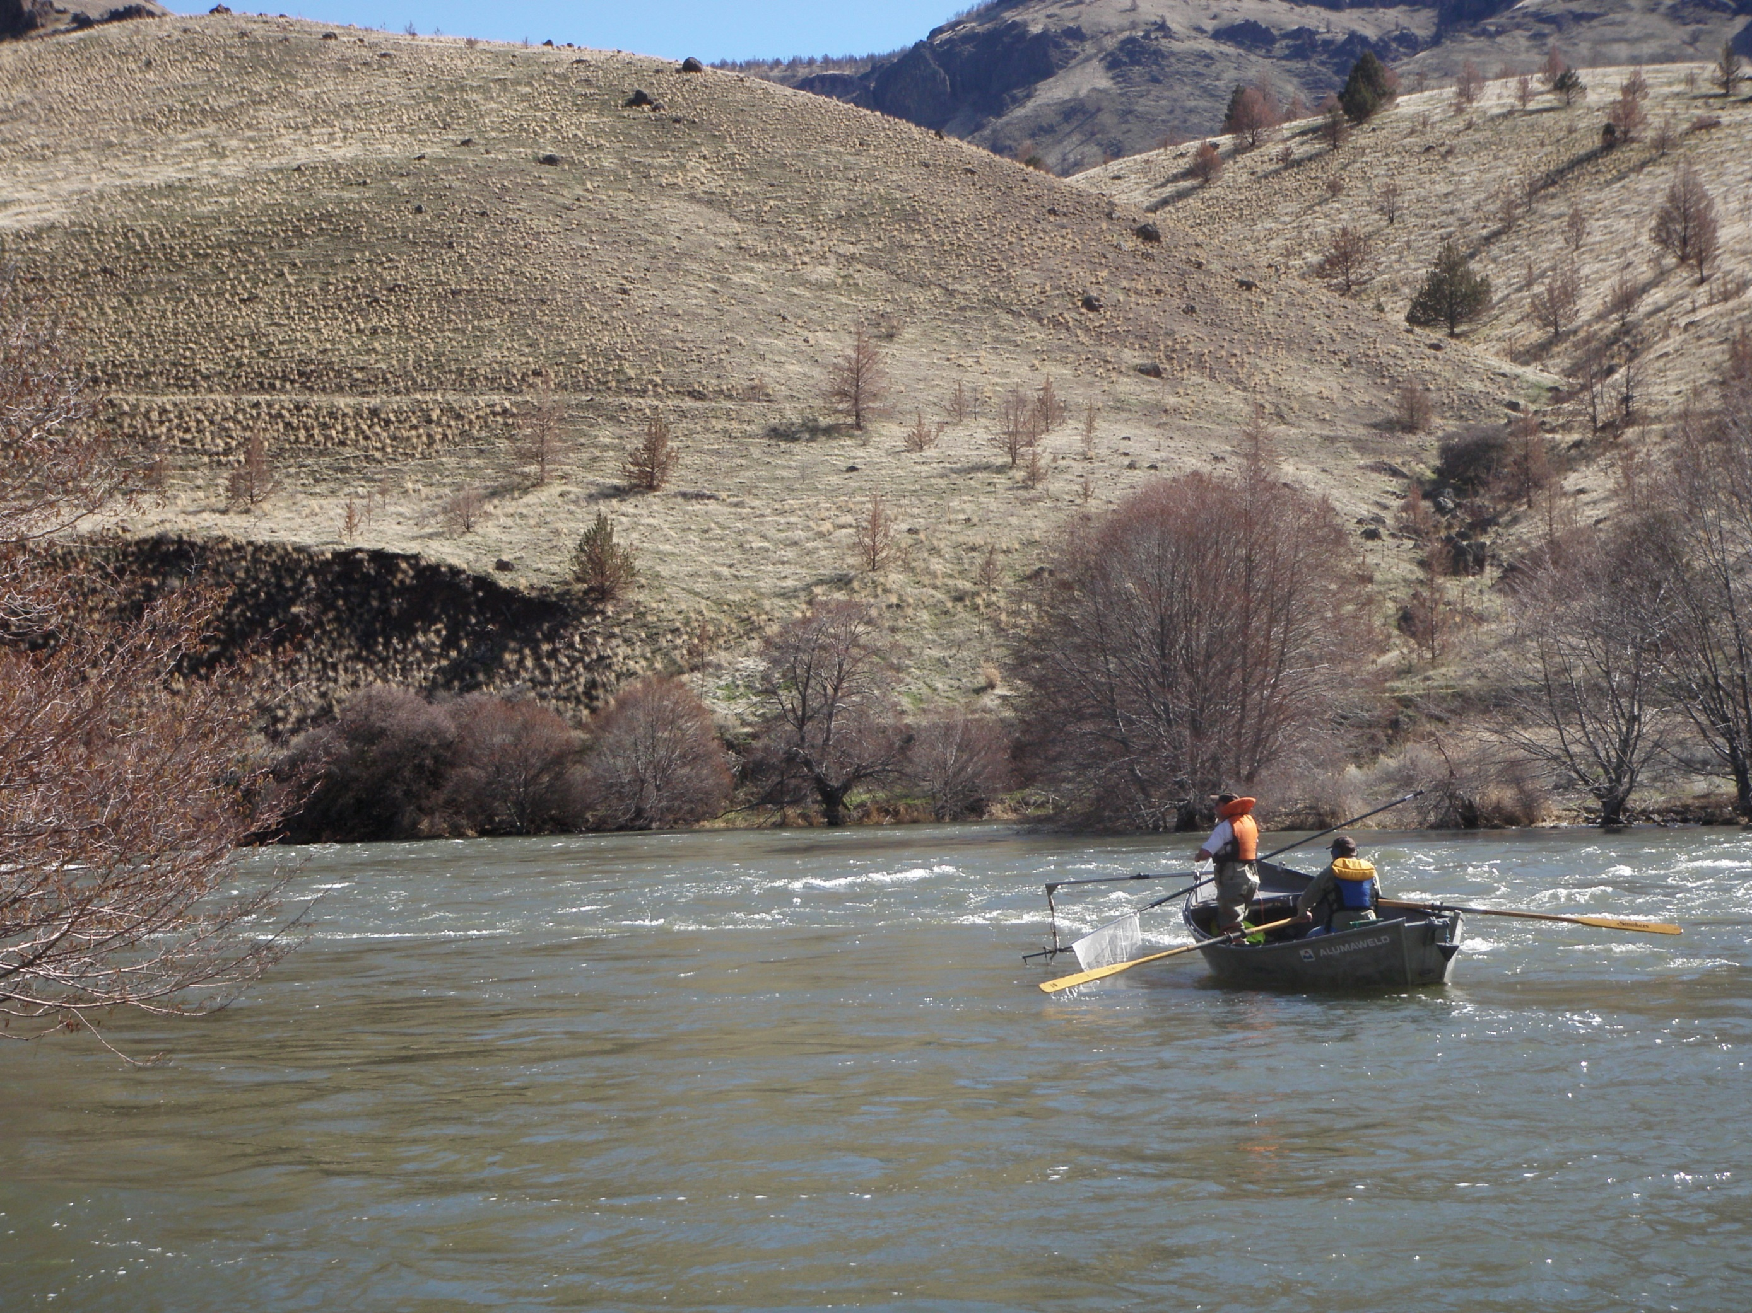

Seven Years of Questions and Concern: What We Know and Don’t Know About The Status of Fish Populations In the Lower Deschutes
Jason Seals
Mid-Columbia Fish District
Oregon Department of Fish and Wildlife

Slide 2
COMMON QUESTIONS
What’s the status of the redband trout population in the Lower Deschutes?
Why are we not catching many hatchery steelhead?
How are the changes in water management affecting other fish populations in the lower Deschutes?

Slide 3
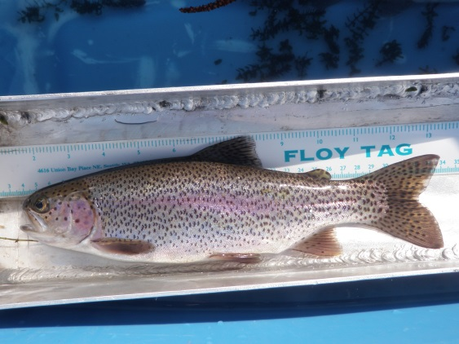
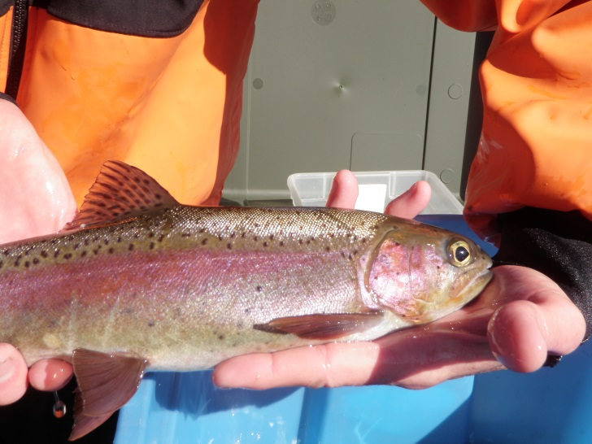
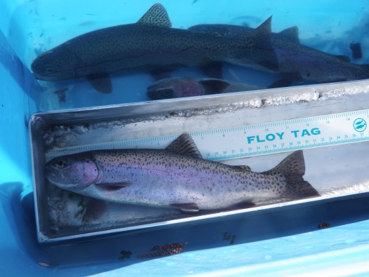
PURPOSE
Monitor and Evaluate the Current Status and Health of Redband Trout in the Lower Deschutes Basin
Notes:
Purpose of the redband trout monitoring.

Slide 4
METHODS
Drift Boat Electrofisher
Historic Monitoring Sections (Trout Creek, N. Junction, Nena, and Jones) (1970’s and 1980’s)
2014-2016
Notes:
We used a drift boat with electrofishing gear to sample trout.
Current monitoring sections were designated and sampled based on the historic sections that were sampled in the 1970’s, 1980’s, and 1990’s.
We have sampled all four sections in late winter/early spring in 2014, 2015, and 2016.

Slide 5
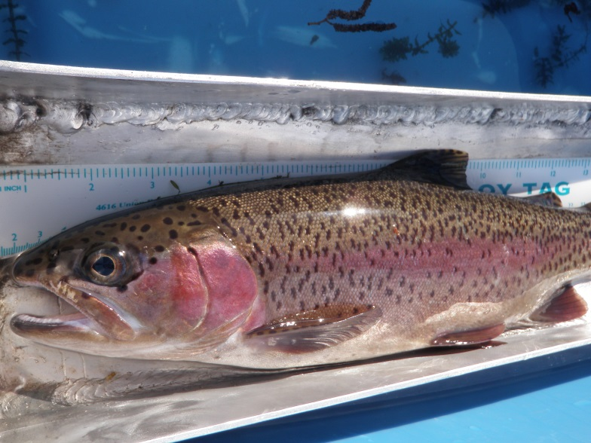
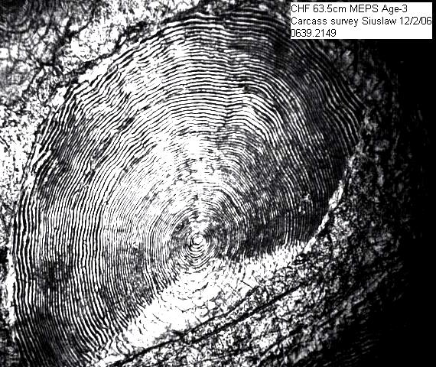
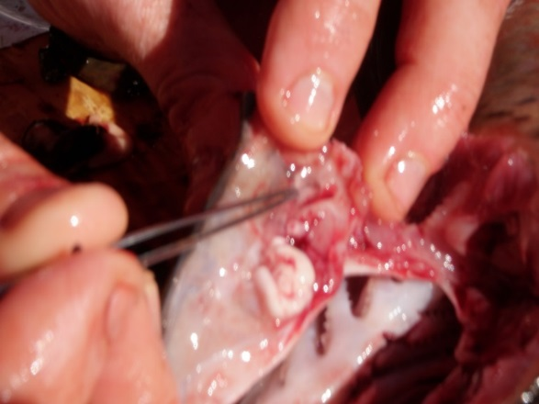
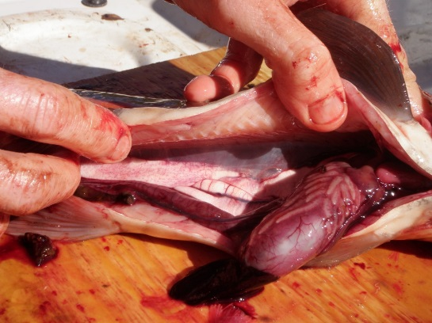
SAMPLE
Length and Weight
Scales
Otoliths, Gender, Stage of Maturity, Stomachs
Notes:
We sampled length and weight and removed scales from live trout. Otoliths and stomachs were removed from lethally sampled fish.
Evaluating the length and weight relationship we can determine the body condition of fish sampled based on the weight of the fish at length. (i.e. how fat or skinny) We are using Fulton’s Condition Factor (K) to determine condition, primarily because (K) was reported in historical reports (Schroeder and Smith 1989).
Scales are mounted and read to determine age distribution, length at age, and back-calculations of growth at age.
Otoliths are taken to evaluate additional age parameters, stomachs are taken from diet analysis, stage of maturity is recorded. This data is not reported in this presentation.

Slide 6
PRESENT TODAY
Growth
Condition Factors
Population Status?

Slide 7
MEAN B-C GROWTH
 | Year(s) | Age
Trout Creek |  | 1 | 2 | 3 | 4 | 5 | 6
 | 1972-75 | 117 | 109 | 73 | 58 | 42
 | 2014 | 117 | 128 | 76 | 41 | 23 | 42
 | 2015 | 121 | 105 | 103 | 26 | 24 | 17
North Junction
 | 1983-86 | 108 | 119 | 77 | 32 | 28 | 11
 | 2014 | 124 | 113 | 67 | 28 | 31
 | 2015 | 133 | 121 | 64 | 35 | 32 | 0
Nena Cr
 | 1983-86 | 111 | 107 | 66 | 29 | 28 | 13
 | 2014 | 117 | 108 | 71 | 35 | 39
 | 2015 | 134 | 116 | 64 | 27 | 22 | 0
Jones Canyon
 | 1986 | 110 | 111 | 70 | 31 | 30 | 21
 | 2014 | 116 | 112 | 74 | 43 | 57
Notes:
Based on the age at length of the fish sampled, we can estimate growth of a trout by examining annulus of trout scales (growth rings), and back-calculate annual growth of each fish we sampled.
The mean back-calculated growth of redband trout sampled in both 2014 and 2015 are in general equal to or higher than data collected in the same sample sections in the 1970’s and 1980’s

Slide 8
CONDITION FACTOR INDEX
GENERAL (K) STANDARDS FOR WILD STREAM SALMONIDS
< 1.0 = Poor Condition
1.0 – 1.1 = Poor to Fair
1.1 - 1.2 = Fair to Good Condition
1.2 - 1.3 = Good to Excellent Condition
> 1.3 = Excellent Condition
Notes:
Standards for (K) in wild stream salmonids are not technically set.
These ranges are displayed to give the audience an idea of what the condition factors infer.
In general, any wild stream salmonid over 1.1 (K) is considered in good natural condition.

Slide 9
CONDITION FACTORS (K)
 |  |  | Immature
 |  |  |  | K |  | N
Nena Creek |  | 1986 |  | 1.25 |  | 91
 |  | 1987 |  | 1.23 |  | 75
 |  | 2014 |  | 1.21 |  | 36
 |  | 2015 |  | 1.24 |  | 29
North Junction |  | 1987 |  | 1.24 |  | 64
 |  | 2014 |  | 1.19 |  | 29
 |  | 2015 |  | 1.28 |  | 27
Notes:
Condition factors of immature redband trout, fish sampled that were less than 300 mm, were similar in 2014 and 2015 to previous estimates of condition.

Slide 10
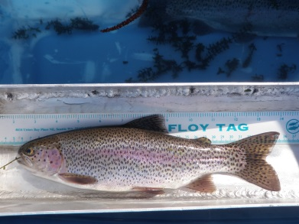
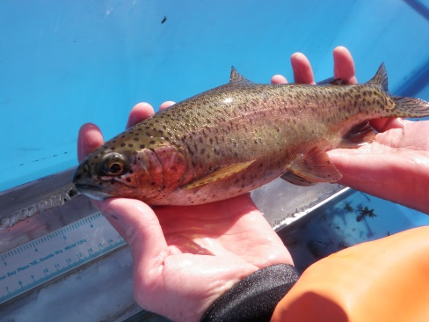
CONDITION FACTORS (K)
 |  |  | Mature
 |  |  |  | K |  | N
Nena Creek |  | 1986 | First Time | 1.27 |  | 90
 |  |  | Repeat | 1.25 |  | 15
 |  |  | Spawn-out | 1.04 |  | 2
 |  | 1987 | First Time | 1.24 |  | 55
 |  |  | Repeat | 1.20 |  | 36
 |  |  | Spawn-out | 1.08 |  | 3
 |  | 2014 | Unknown | 1.22 |  | 37
 |  |  | Known | 1.26 |  | 14
 |  | 2015 | Unknown | 1.19 |  | 39
 |  |  | Known | 1.14 |  | 17
Notes:
Condition factor estimates of mature trout were also very similar to previous estimates.
Unknown mature trout were fish measured greater than 300 mm.
Known mature trout were fish that were lethally sampled.

Slide 11
CONDITION FACTORS (K)
 |  |  | Mature
 |  |  |  | K |  | N
North Junction |  | 1987 | First Time | 1.26 |  | 33
 |  |  | Repeat | 1.19 |  | 35
 |  |  | Spawn-out | 1.07 |  | 4
 |  | 2014 | Unknown | 1.25 |  | 62
 |  |  | Known | 1.24 |  | 19
 |  | 2015 | Unknown | 1.21 |  | 73
 |  |  | Known | 1.19 |  | 8
Notes:
See previous slide
Of note, in literature searches, reports from similar studies have reported K factors of wild stream rainbow trout on the Kanektok River, Alaska, at 1.15 (with some variation based on age)(Wagner 1991) and on the Kings River (tailwater below Pine Flat Dam) at 1.13 on average (Hanson 2005).

Slide 12
POPULATION STATUS???
We Don’t Know Abundance
What We Do Know Is Health
ANNUAL VARIABILIY IN DENSITY IS NOT A RECENT PHENOMENON
Notes:
We have not conducted surveys to estimate redband densities due to the expense, time demand, and the fact that our ability to measure change based on density estimates would be questionable due to wide confidence intervals and extreme natural variation in densities within these study areas (see next slide).

Slide 13
TROUT DENSITY
Notes:
Previous density estimates in the North Junction study area shows that natural variability and fluctuations of trout densities can be extreme from year to year. So again, measuring change could be very difficult.
Also, please note the wide confidence intervals on some years, which also complicates measuring change.

Slide 14
SUMMARY
Growth Looks Good (2014-15)
Body Condition Good (2014-15)
Densities Highly Variable Naturally
Detecting Change By Estimating Densities Difficult
Notes:
Growth rates from back calculations from length at age were good in 2014 and 2015 and similar to historical data in Schroeder (1989), the current data suggests it is slightly better than historical back calculations, we will continue to evaluate if growth is as good or better than historical data.
Fish condition of the fish sampled in 2014 and 2015 was good. Current data is very similar to data reported in Schroeder (1989).
There has been continual questions regarding ODFW not estimating fish densities, we are reluctant to estimate densities for a number of reasons, primarily we feel our ability to detect change from prior to the selective water withdrawl would be very difficult due to previous data showing that densities of redband trout in the Deschutes are highly variable (please see next slide).
We have seen no signs of population stress such as a precipitous decline in growth or condition of redband when comparing our current data to historical data.

Slide 15
WHY ARE WE NOT CATCHING HATCHERY FISH?
Anglers Love ‘Em and Conservationists Love to Hate ‘Em
Notes:
Steelhead anglers in the lower Deschutes have been reporting and discussing low numbers of hatchery fish in the lower Deschutes from what they can recall catching in the past. This is not their imagination, anglers have in fact been catching fewer hatchery steelhead in the past several years.

Slide 16
RBH AND OOB STRAY HATCHERY STS ESCAPEMENT OVER SHERARS FALLS
Notes:
The simple reason why anglers are catching fewer hatchery steelhead in the Deschutes is that there are fewer hatchery fish present than the previous about 15 years. The number of out of basin hatchery strays in the Deschutes are the lowest they have been since the mid 1990’s. We estimated a range from about 5,000 to 25,000 out of basin strays upstream of Sherars Falls from the late 1990’s to 2010 and have seen a decline to about 2,000 strays in 2015. Round Butte (Deschutes Stock) hatchery fish generally range from about 3,000 to 5,000 per year.
Our creel data shows that out of basin strays have traditionally accounted for about 70% of the hatchery fish harvested on average in the lower 43 miles of the Deschutes fishery.

Slide 17
ESTIMATED WILD CATCH AND HATCHERY HARVEST
Notes:
Wild steelhead continue to be the largest component of the estimated steelhead catch in the lower 43 miles of the Deschutes fishery averaging several thousand fish caught per year. In contrast, hatchery fish harvested appears to be slightly declining.

Slide 18
TEMPERATURE RELATED?
Hatchery Steelhead Passage Over The Dalles Dam
Notes:
Many anglers have theorized that changes in water temperatures from the SWW have reduced the number of steelhead straying into the Deschutes. We don’t believe that is the case.
This graph displays hatchery steelhead passage over The Dalles Dam in 2014 and 2015. As you can see, the bulk of the run occurs at the very end of August and continues through September. However….see next slide.

Slide 19
Notes:
Prior to 2010, peak high water temperatures in the lower Deschutes occurred in late August and September (Black line in Graph). Under the new temperature controls to mimic a more natural temperature regime, peak water temperatures occur in July (2015 observed in blue).
If steelhead stray rates were driven by temperatures, more steelhead should be straying under the current temperature releases than prior to the temperature control due to the bulk of the hatchery run passing over The Dalles Dam in late August and September where temperatures are now colder than prior to 2010.

Slide 20
John Day PHoS and Barge Transportation
Ian Tattum - ODFW
Notes:
We believe the most likely reason for the reduction of strays in the Deschutes is due to the reduction of smolt barging in the Columbia River, as mandated in the Columbia River BiOp.
In the John Day Basin, we have also observed a reduction in strays as shown by the gray bars which represent the PHoS (Percent Hatchery on Spawning grounds). The reduction in strays corresponds to the reduction in PHoS in the John Day Basin.

Slide 21
Proportion Transported Columbia Basin
McCann et. Al.
Notes:
Proportion of wild steelhead barged, represented by the dashed line, was also significantly reduced.

Slide 22
OOBS SUMMARY
Proportions of Out of Basin Strays are Currently Low
Does Not Appear to be Temperature Related
Straying Highly Correlated to Barging
Low Stray Rates May Continue

Slide 23
OTHER SPECIES OF CONCERN??
WILD FALL CHINOOK
WILD STEELHEAD

Slide 24
WILD FALL CHINOOK
Notes:
We have estimated total escapement of adult wild fall chinook in the Deschutes River since 1977. The past five run years have been some the highest on record.

Slide 25
WILD STEELHEAD ESCAPEMENT ABOVE SHERARS
Notes:
Wild steelhead estimates above Sherars Falls have remained stable, comparable to most years on record.

Slide 26
FINAL SUMMARY
Wild Steelhead Returns Good
Wild Fall Chinook Returns All Time High’s

Slide 27
Special Thanks
Bret Hodgson, Jeremy Stahler, Laura Street, Tom Nelson, Frank Hermens, Seth Taylor, Erik Moberly, Mike Gauvin, Bob Hooton, Rick Hafele, Greg McMillan, OSU Cascades Campus, Rick Golden, Josh McCormick, Rod French, Graham Boostrum, Michael Turner, Cyndi Baker, Lyman Jim, Becky Burchell, Round Butte Hatchery, WSNFH, and PGE
Funding Primarily Provided by U.S. Fish and Wildlife Service Sport Fish Restoration and Oregon Department of Fish and Wildlife

