Slide 1
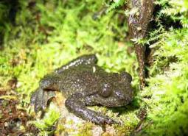
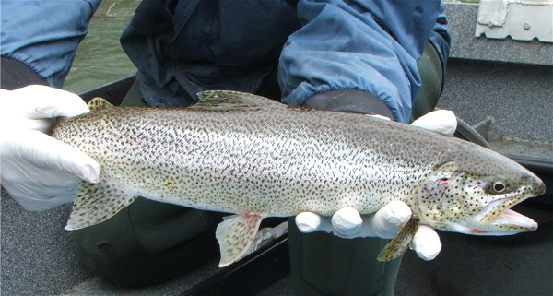
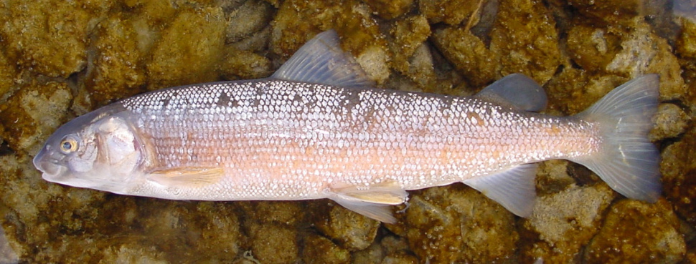
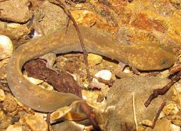
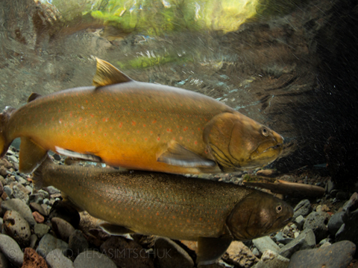
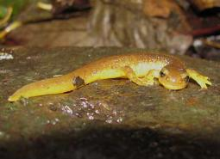
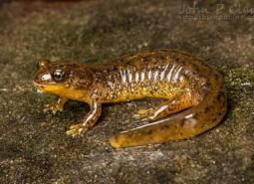
PFA HCP Mitigation Fund Guidance for USFWS Species
Coastal tailed frog
Coastal cutthroat trout
Mountain whitefish
Cope’s giant salamander
bull trout
Chris Allen
Aquatic Resources Division Manager
USFWS, Oregon Fish and Wildlife Office
Southern torrent salamander
Columbia torrent salamander

Slide 2
Presentation Objectives
Review list of covered species under jurisdiction of USFWS
Touch on some resources for applicants & reviewers to determine appropriateness of mitigation projects submitted for mitigation funding
ESA coverage for mitigation funded prior to and post HCP finalization
Determining adequacy of mitigation actions under the HCP
Additional issues under discussion internally and externally

Slide 3
USFWS Covered Species
Bull trout – listed threatened (OR, WA, ID, NV, MT) – also an *ODFW strategy species
Lahontan cutthroat trout – listed threatened (OR, CA, NV) – also an *ODFW strategy species
Coastal cutthroat trout - no fed status – *ODFW strategy species
Rainbow & redband (interior) trout - no fed status – *ODFW strategy species
Great Basin redband trout - no fed status – *ODFW strategy species
Westslope cutthroat trout (John Day Basin only) – no fed status – *ODFW strategy species
Mountain whitefish – no federal status
Columbia torrent salamander – petitioned for listing; 12mo finding due FY24 -*ODFW strategy species
Southern torrent salamander - no federal status (not warranted finding 2000) – *ODFW strategy species
Coastal giant salamander – no federal status
Cope’s giant salamander - no federal status – *ODFW strategy species
Coastal tailed frog - no federal status – *ODFW strategy species
* ODFW’s Oregon Conservation Strategy Species = those having small or declining populations or are otherwise at-risk; Also referred to as Oregon’s Species of Greatest Conservation Need

Slide 4
ODFW’s Oregon Conservation Strategy
Reviewed & Approved by USFWS in 2016
Overarching plan to conserve Oregon’s fish and wildlife & their habitats. Combines best available science and conservation priorities with recommended voluntary actions and tools.
Strategy Species: 294 species of greatest conservation need (60 fish, 17 amphibians)
Strategy Habitats – 11 native habitats of conservation concern
Conservation Opportunity Areas – 206 priority areas across Oregon
Key Conservation Issues – 7 statewide threats affecting OR’s fish & wildlife

Slide 5
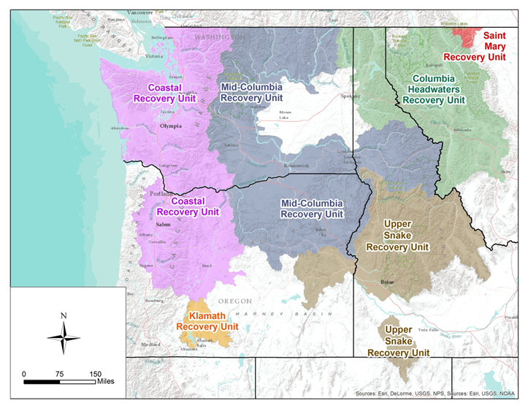
Bull Trout Recovery Planning
2015 Recovery Plan
6 Recovery Unit Implementation Plans
Oregon Strategy
Species Status Assessment 2023
5-year review 2023

Slide 6
Conservation Planning for Remaining Covered Fish
Coastal cutthroat trout– all 4 *SMUs have a state assessment; 2 have a completed state *C&R plan
Rainbow & redband (interior) trout – NMFS recovery plans for listed steelhead DPS’s
Great Basin redband trout – 7 *SMUs identified– all have a state assessment, no state C&R plan
Westslope cutthroat trout – state assessment completed but no state C&R plan
Mountain Whitefish - no state assessment – no state C&R plan
Lahontan cutthroat trout – state assessment completed for both *SMUs in OR – completed federal recovery plan
*C&R Plan = ODFW developed Conservation and Recovery Plan
*SMU = Species Management Unit (ODFW term)

Slide 7
Conservation Planning for Covered Amphibians
Columbia torrent salamander – Predominantly on private (68%) and state land (25%). Distribution limited to extreme NW OR.
Southern torrent salamander – Distribution = W. OR coast range south of Lincoln City
Coastal giant salamander – West of Cascade crest in Oregon
Cope’s giant salamander – Extreme NW OR + northern portion of Mt. Hood NF
Coastal tailed frog – all of western OR including Cascades
All with exception of Coastal giant salamander, are Oregon Strategy Species covered under ODFW’s Oregon Conservation Strategy

Slide 8
Mechanisms for ESA Section 7 Coverage for Mitigation Fund Actions Implemented Prior to HCP
Many (most?) restoration projects funded prior to HCP completion would need an individual Corp permit, which would trigger consultation with USFWS on issuance of the permit (i.e., ESA coverage)
Many PFA Mitigation Fund actions within the range of bull trout that could require a Corps permit may fall under an existing SLOPES Programmatic Consultation between the FWS and USACE in Oregon

Slide 9
Incidental Take Permit Issuance Criterion for Mitigation
Actions that offset impacts to covered species and their habitats expected to remain after avoidance and minimization measures outlined in the HCP are implemented

Slide 10
Topics Under Consideration
Will the HCP provide ESA take coverage for the Mitigation Fund Program?
How do other watershed grant programs (e.g. OWEB) function re: ESA permitting?
During HCP development, should an advanced mitigation plan be developed & memorialized in a formal agreement with the Services (HCP handbook Sxn 3.5.7)?
What instrument will be used to track advanced mitigation? Who will manage it?
How will the Services have enough certainty that mitigation will “fully offset” adverse effects of the covered activities in order to be able to issue an ITP?
How are newly listed species accommodated within an existing HCP?

